Slide 1
Ottmar Edenhofer
Co-Chair, IPCC Working Group III

Slide 2
IPCC reports are the result of extensive work of many scientists from around the world.
1 Summary for Policymakers
1 Technical Summary
16 Chapters
235 Authors
900 Reviewers
More than 2000 pages
Close to 10,000 references
More than 38,000 comments

Slide 4
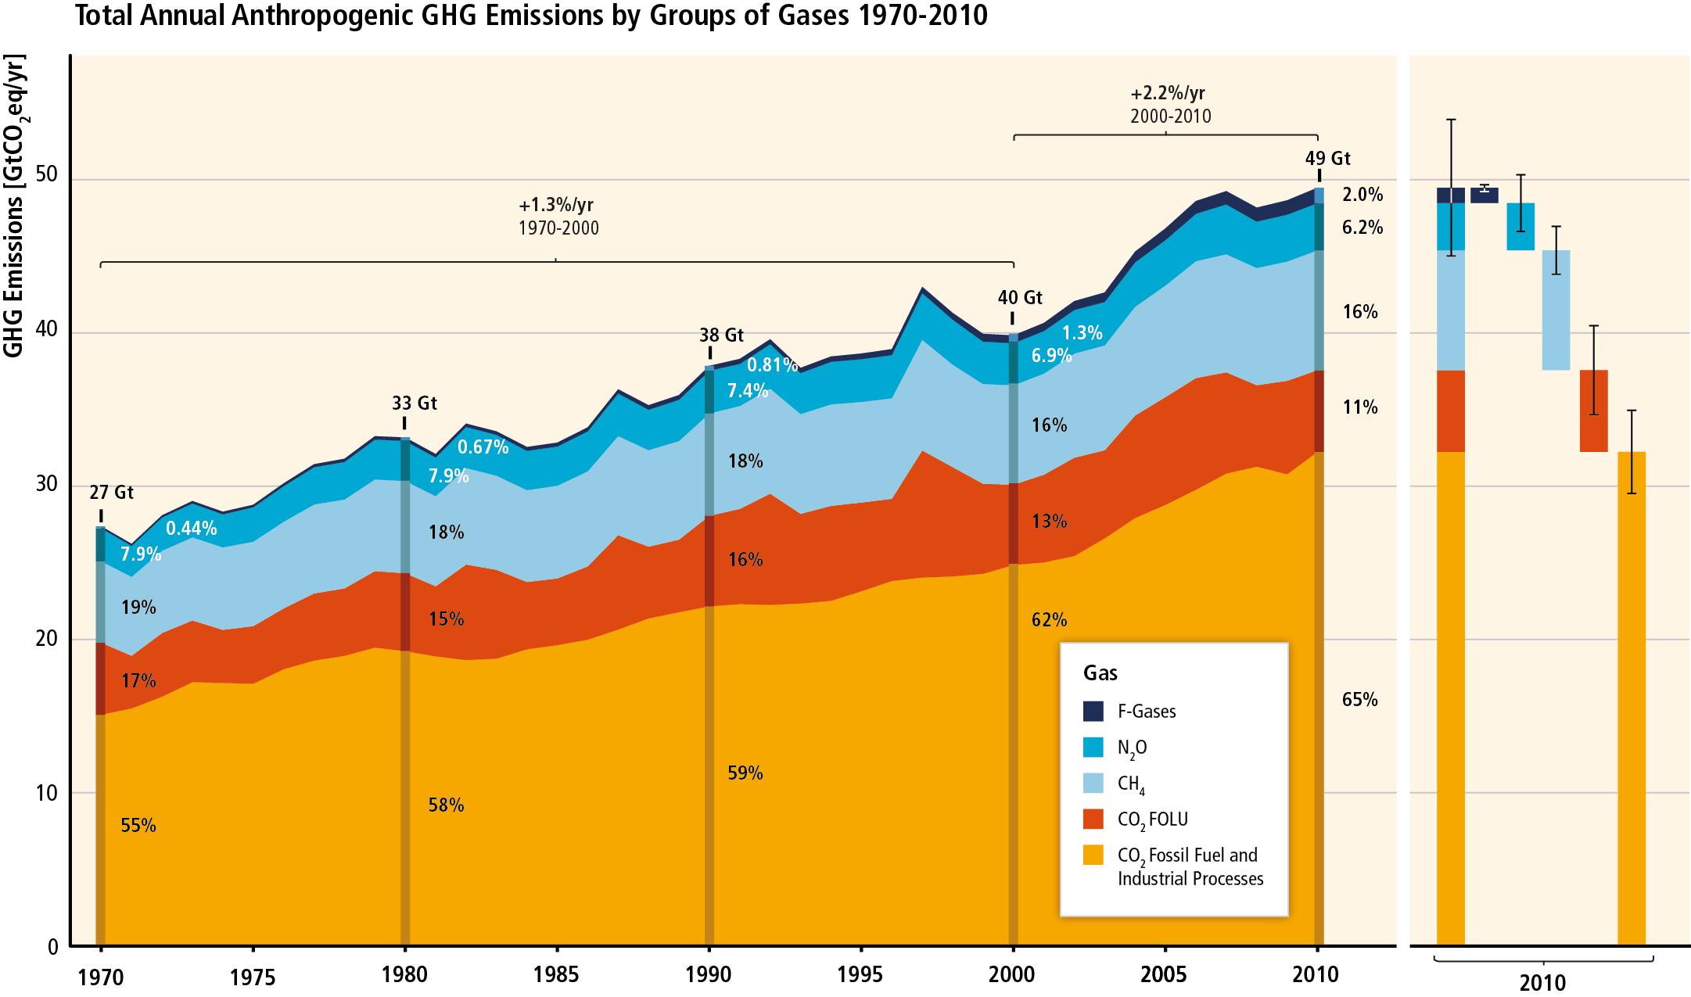
GHG emissions accelerate despite reduction efforts. Most emission growth is CO₂ from fossil fuel combustion.

Slide 5
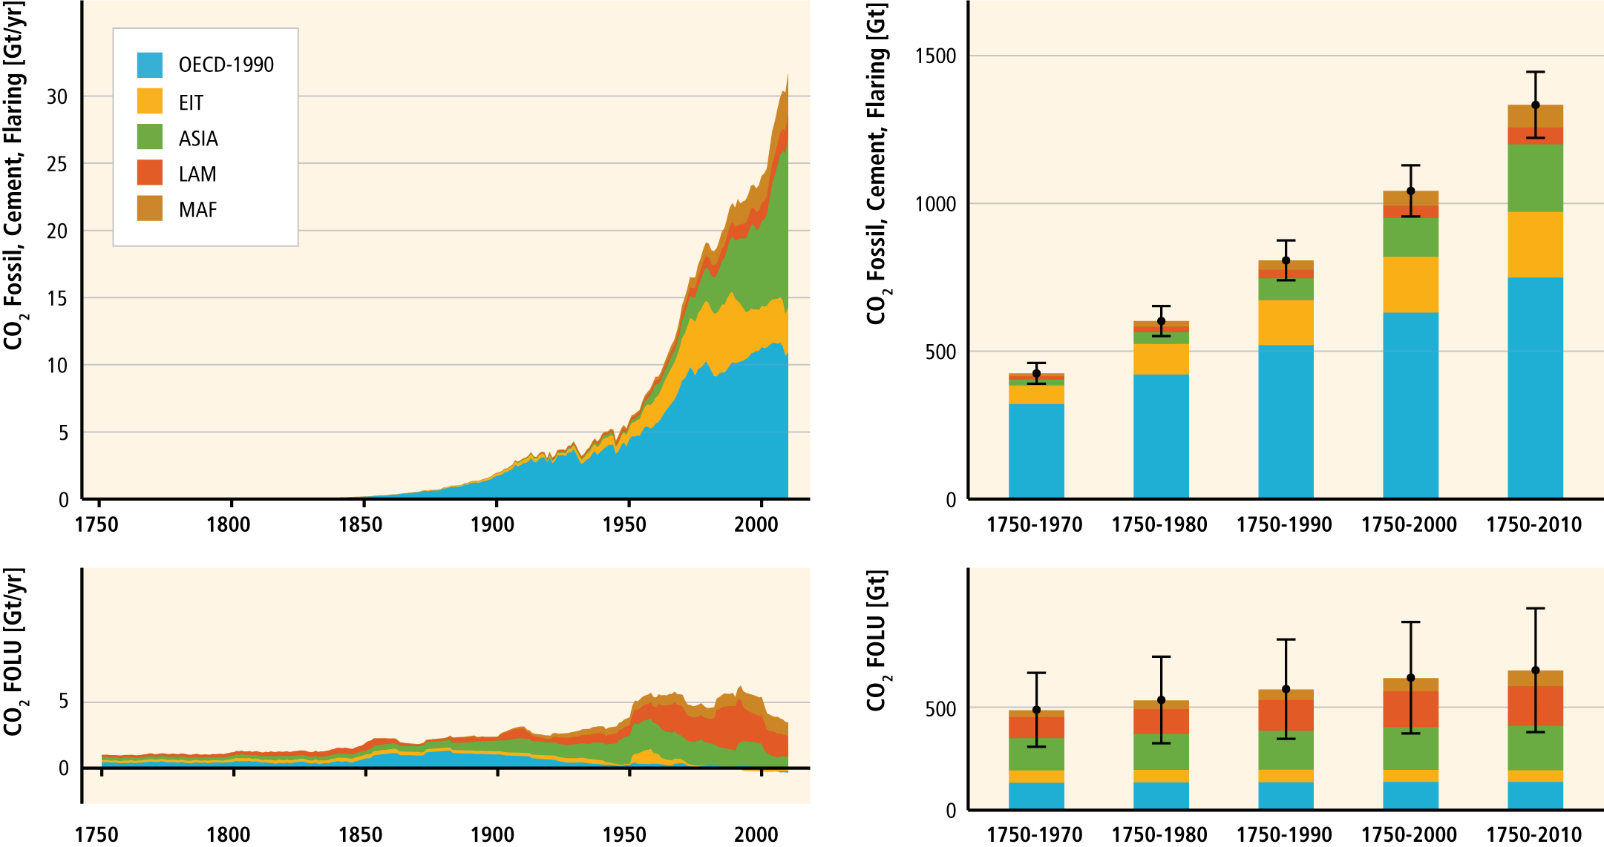
Cumulative CO₂ emissions have more than doubled since 1970.

Slide 6
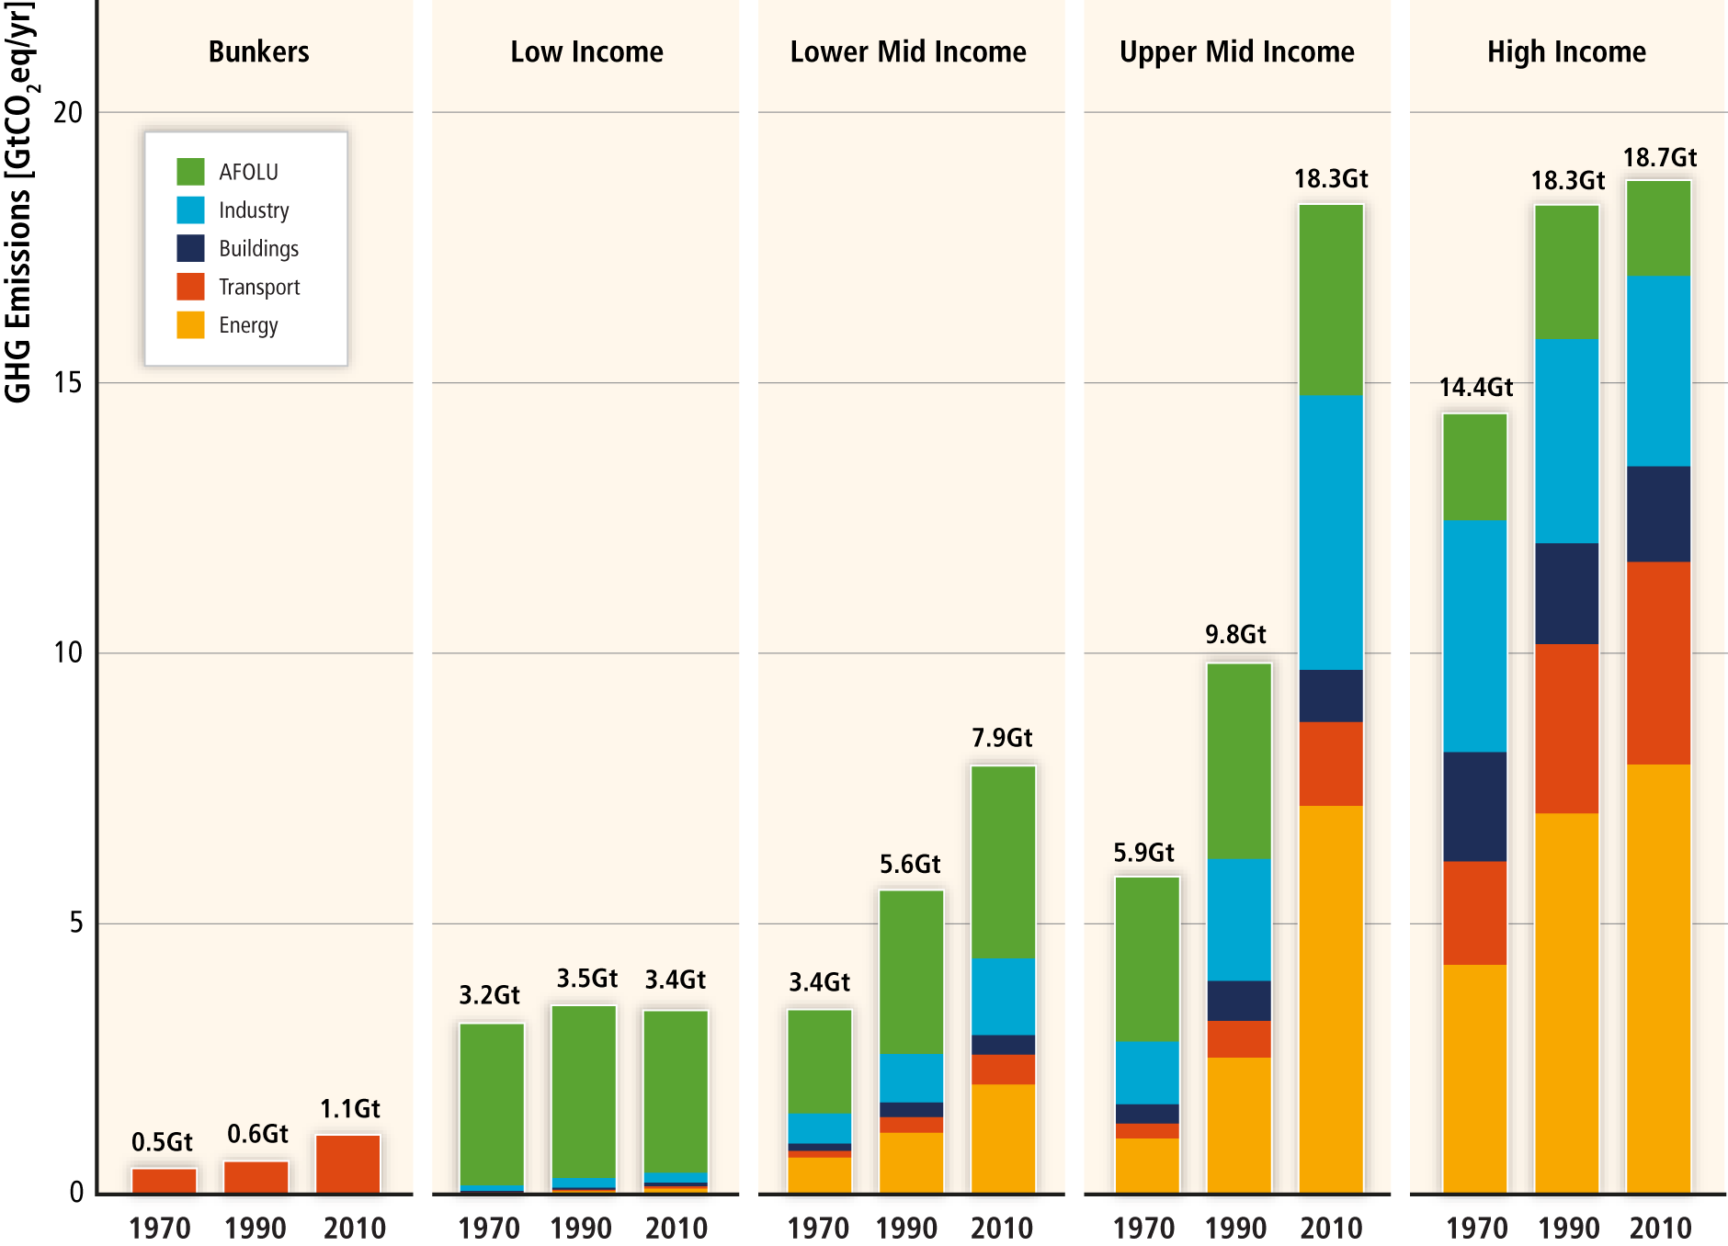
Regional patterns of GHG emissions are shifting along with changes in the world economy.

Slide 7
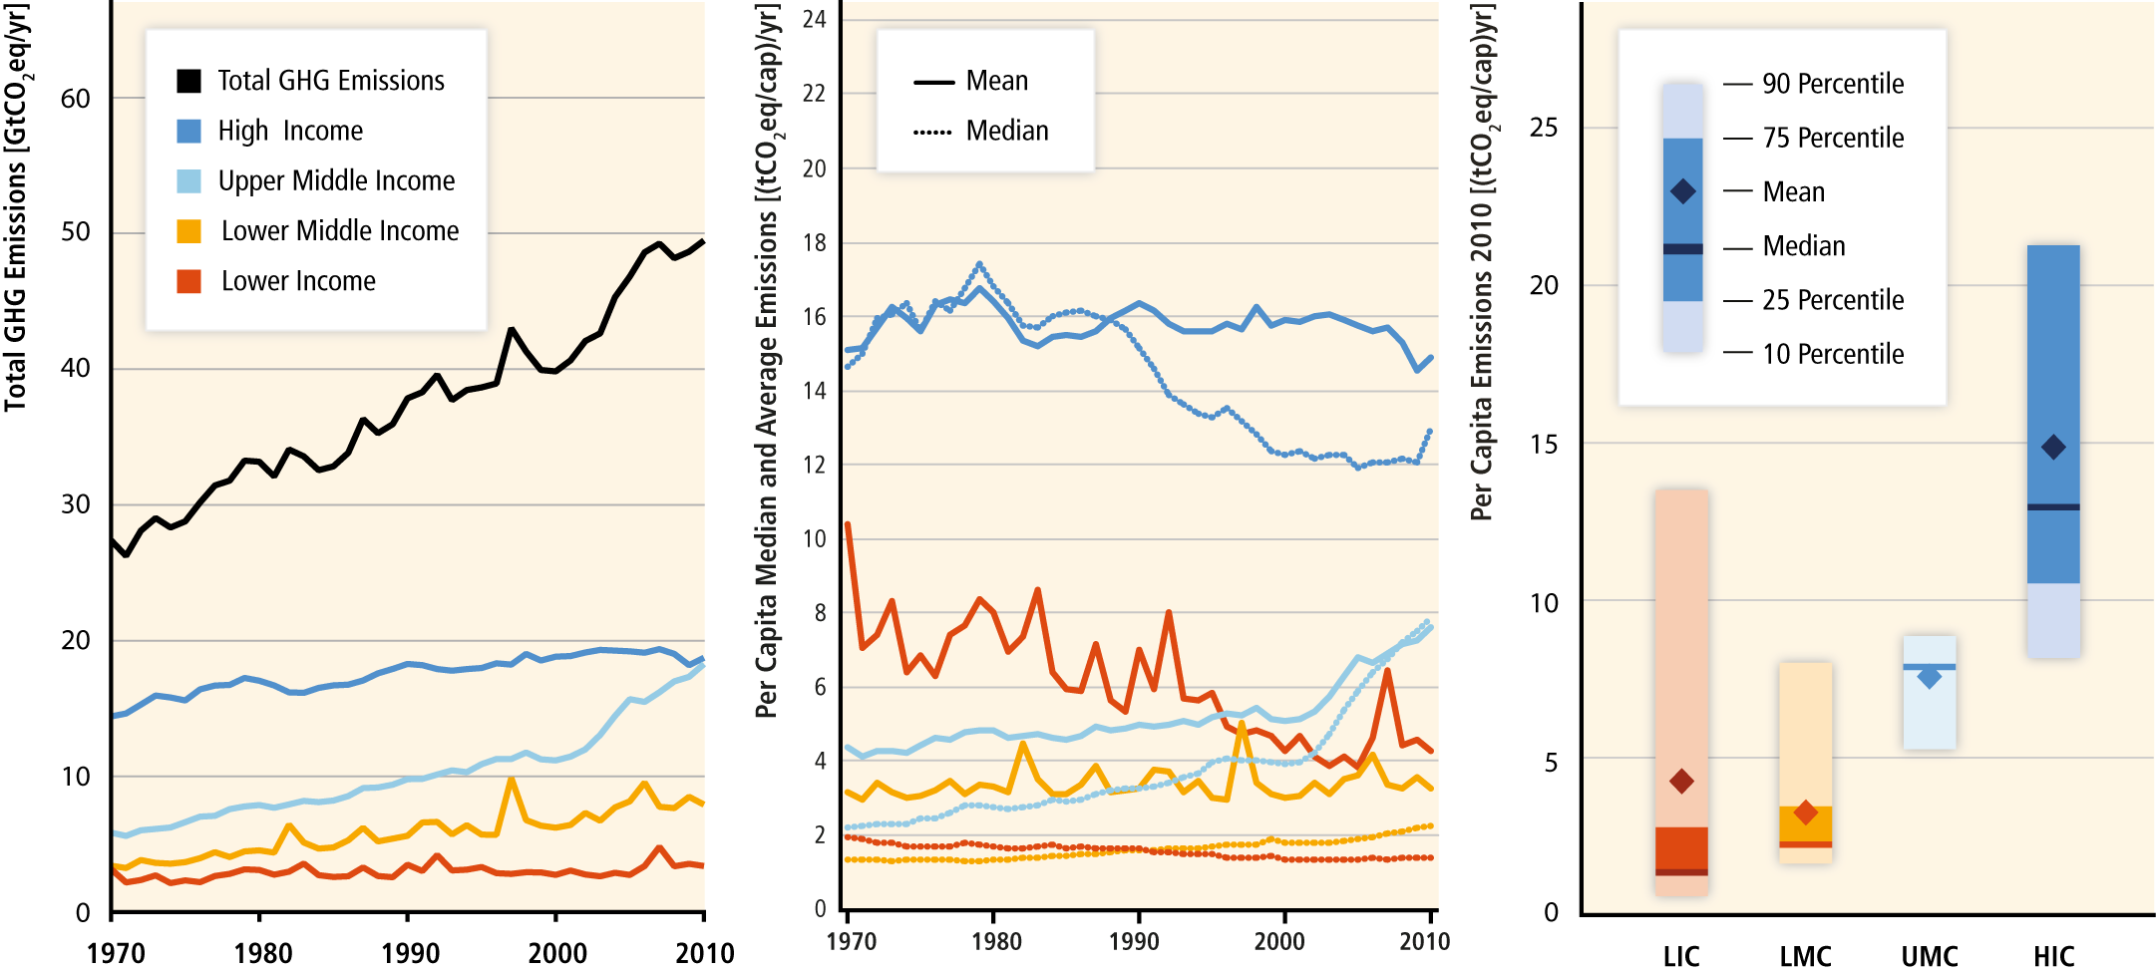
National per‐capita GHG emissions are highly variable within and between income groups.

Slide 8
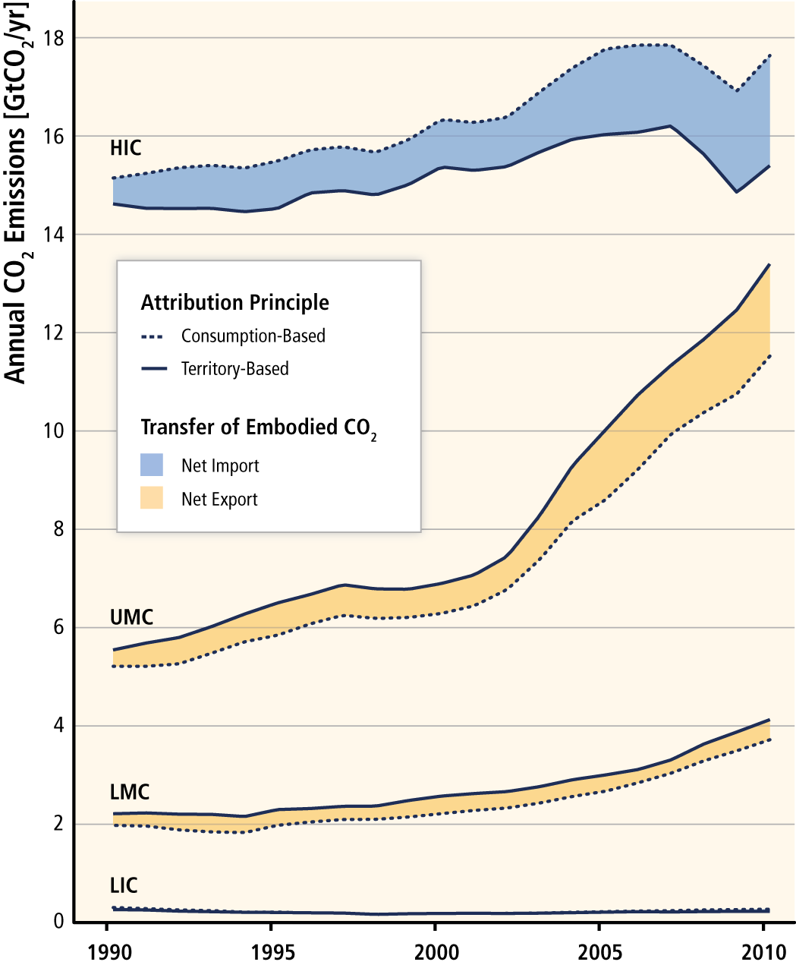
A growing share of CO₂ emissions from fossil fuel combustion and industrial processes in low and middle income countries has been released in the production of goods and services exported, notably from upper‐middle income countries to high income countries.

Slide 9
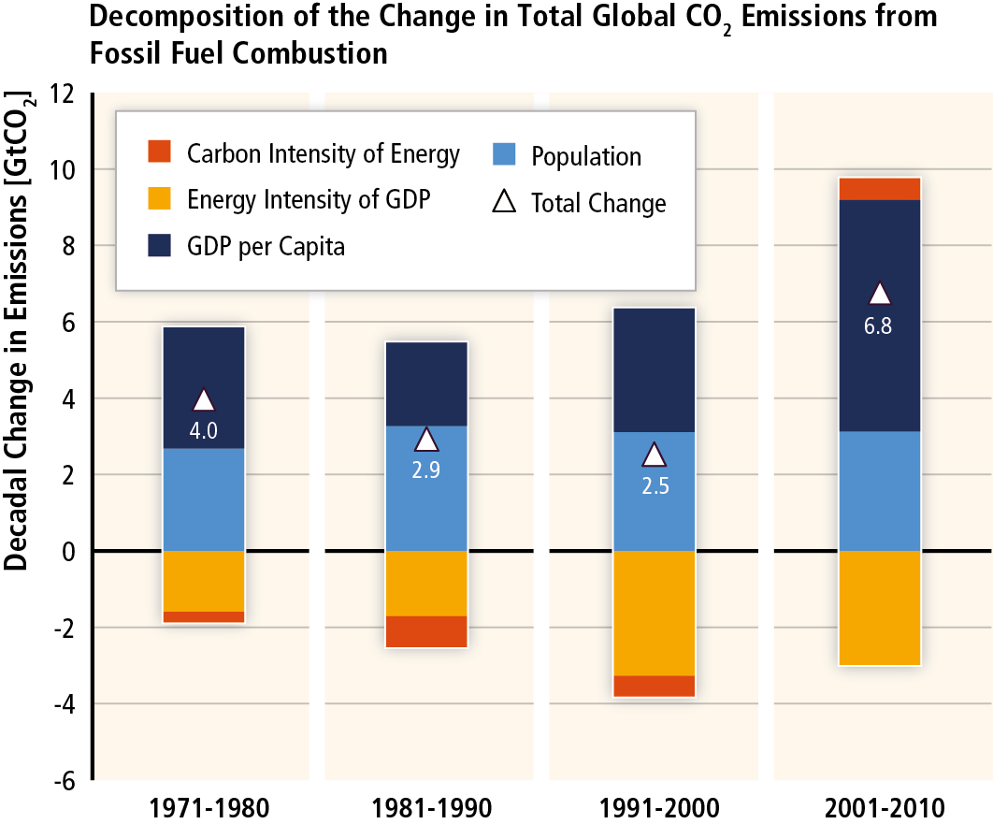
GHG emissions rise with growth in GDP and population; long-standing trend of decarbonisation of energy reversed.

Slide 10
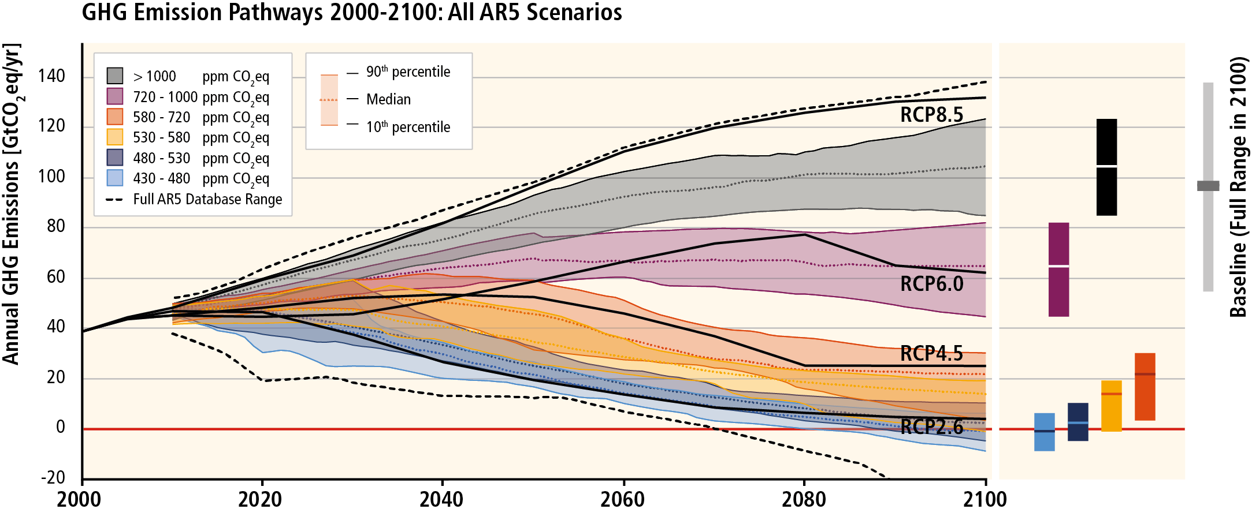
Without more mitigation, global mean surface temperature might increase by 3.7° to 4.8°C over the 21st century.

Slide 11
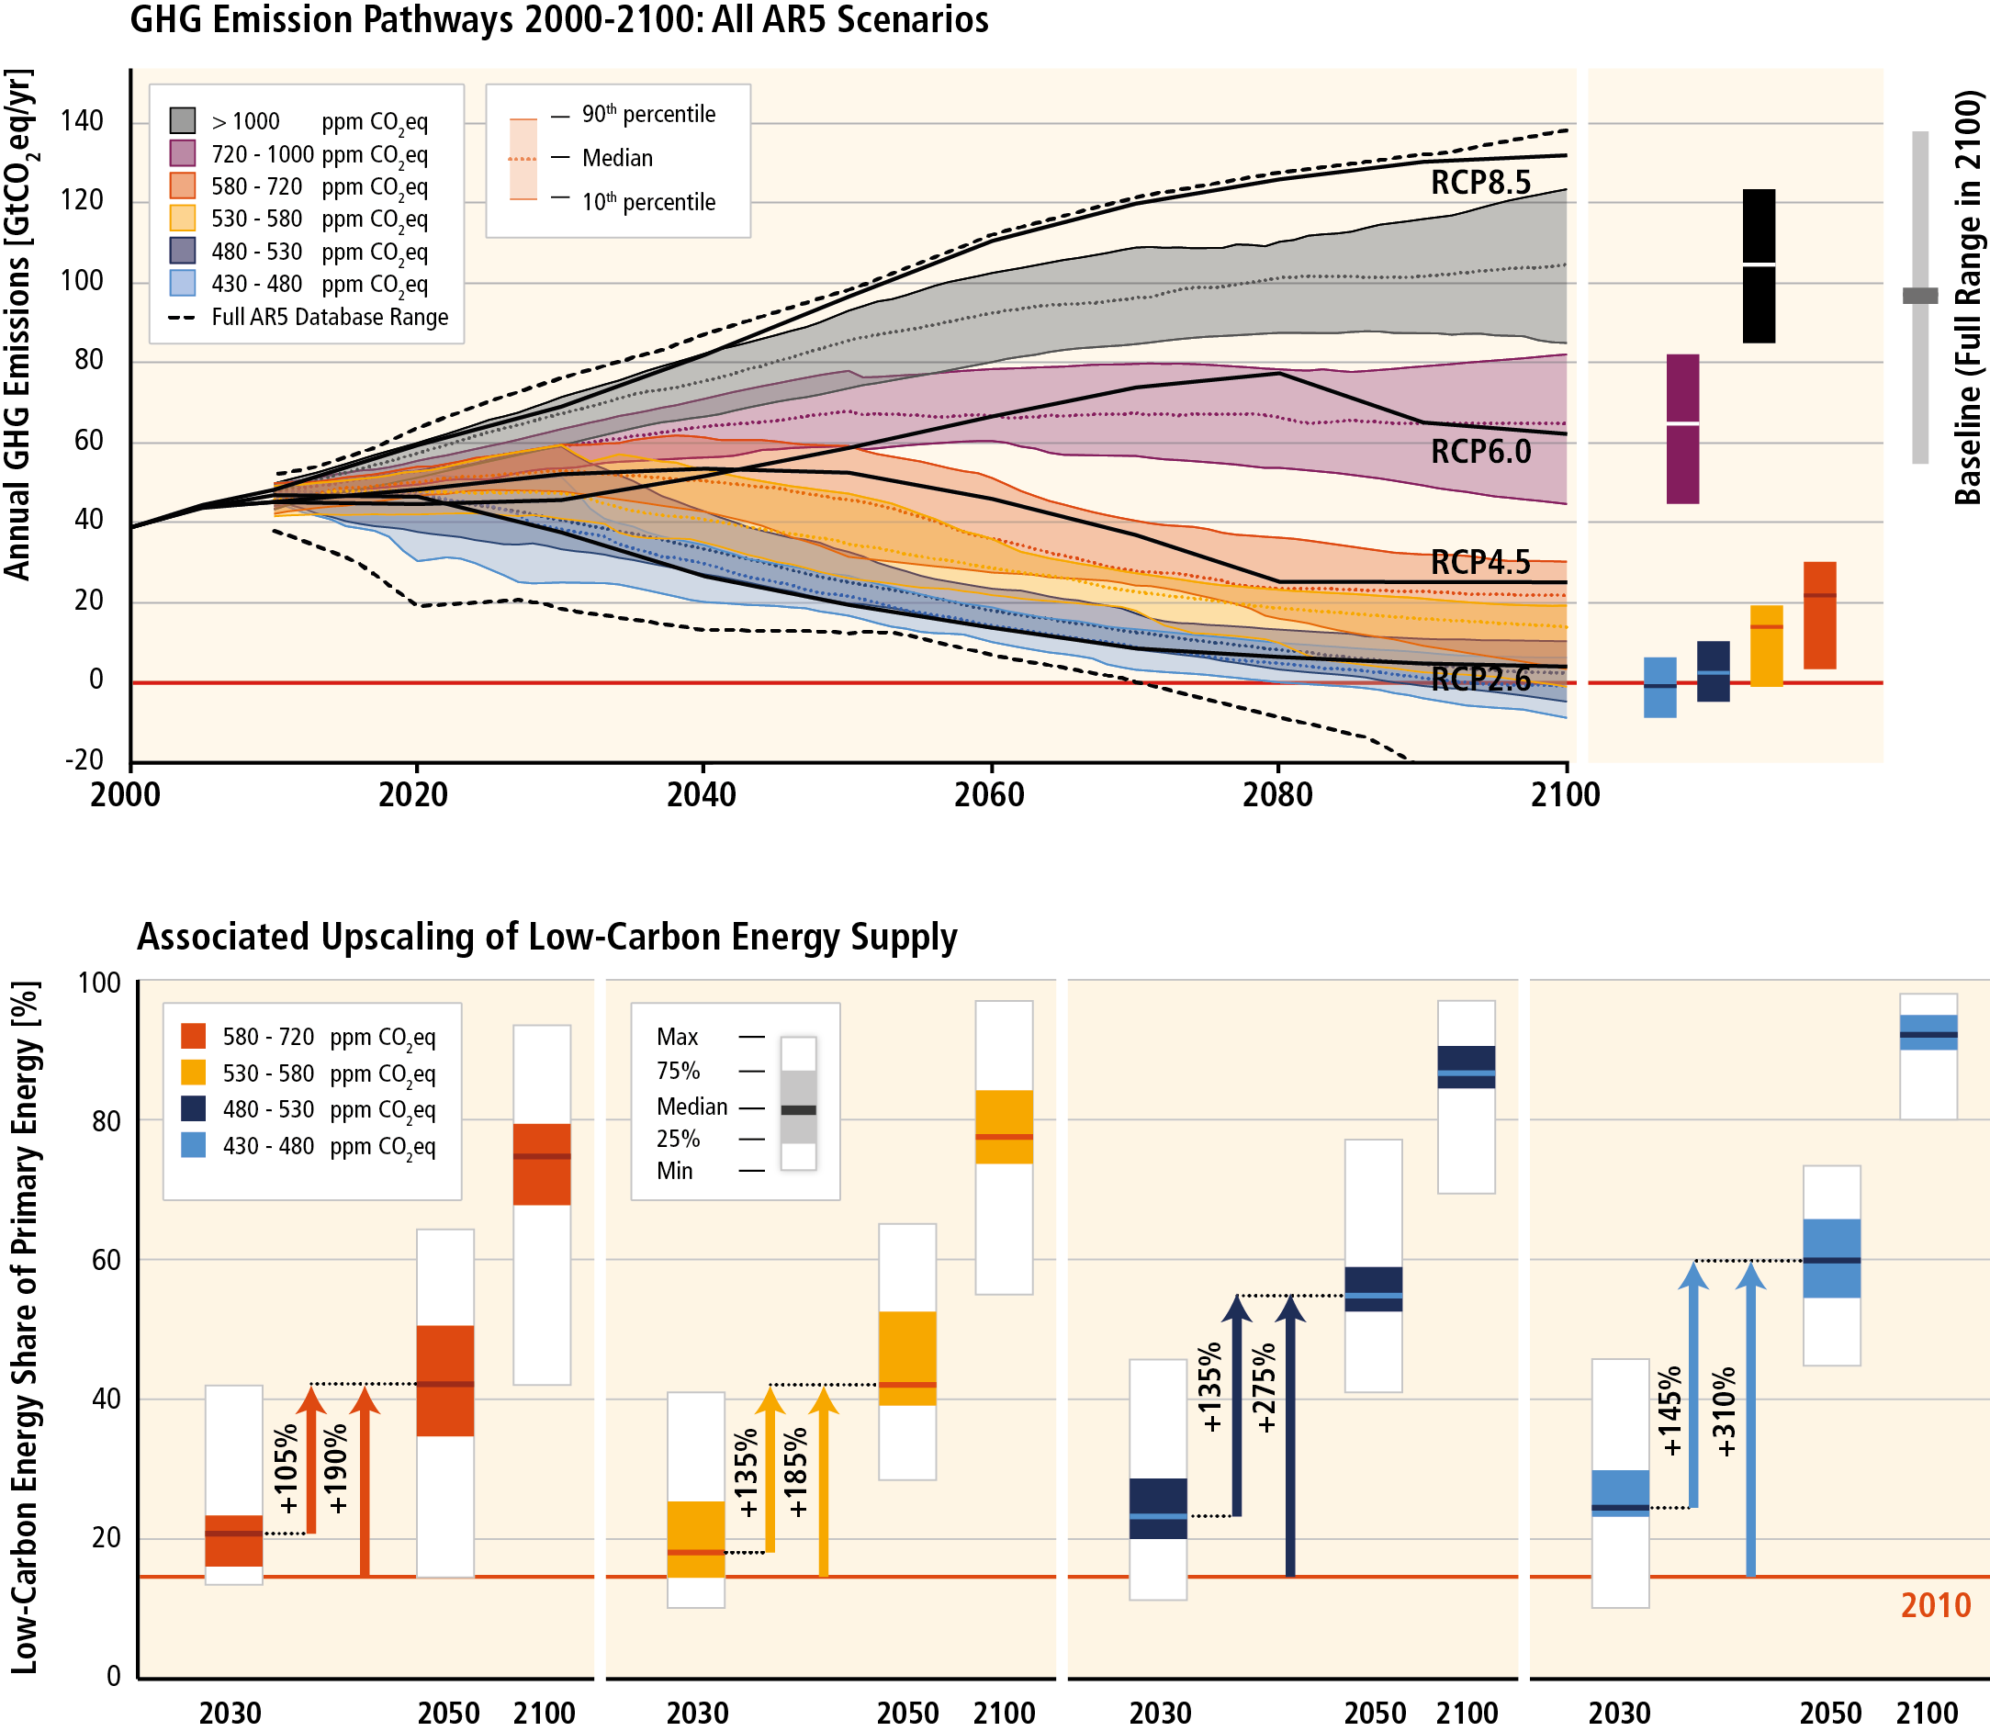
Mitigation requires major technological and institutional changes including the upscaling of low- and zero carbon energy.

Slide 12
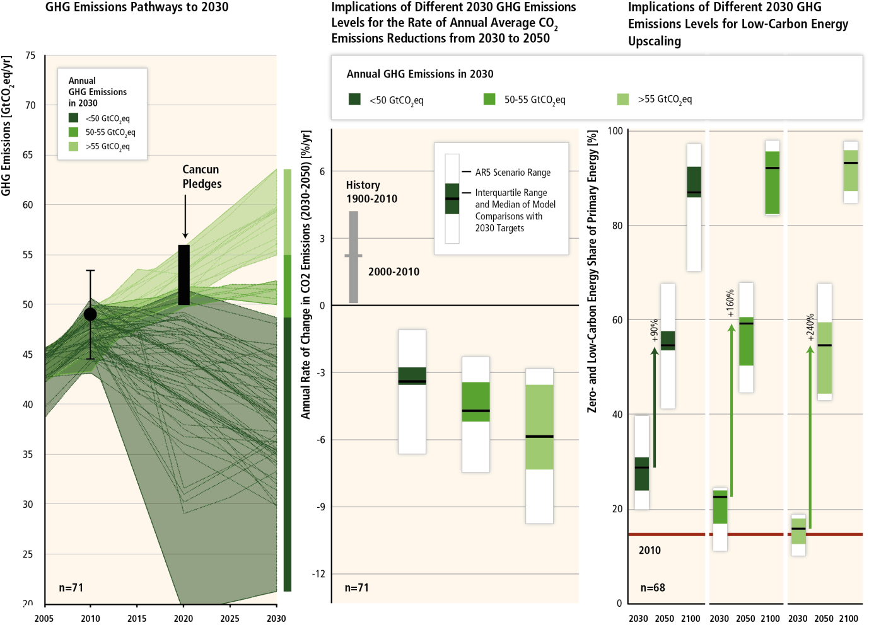
Delaying mitigation is estimated to increase the difficulty and narrow the options for limiting warming to 2°C.

Slide 13
Estimates for mitigation costs vary widely.
Reaching 450ppm CO₂eq entails consumption losses of 1.7% (1%-4%) by 2030, 3.4% (2% to 6%) by 2050 and 4.8% (3%-11%) by 2100 relative to baseline (which grows between 300% to 900% over the course of the century).
This is equivalent to a reduction in consumption growth over the 21st century by about 0.06 (0.04-0.14) percentage points a year (relative to annualized consumption growth that is between 1.6% and 3% per year).
Cost estimates exlude benefits of mitigation (reduced impacts from climate change). They also exclude other benefits (e.g. improvements for local air quality).
Cost estimates are based on a series of assumptions.

Slide 14
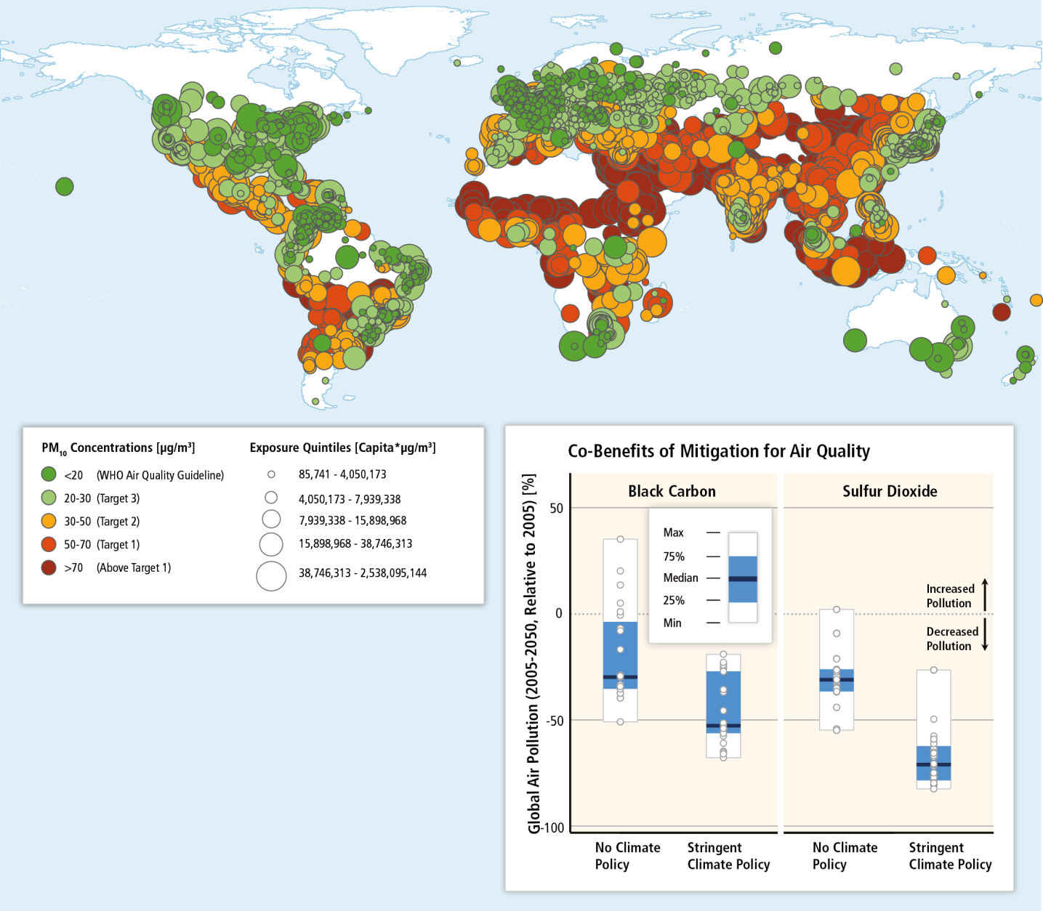
Mitigation can result in large co-benefits for human health and other societal goals.

Slide 15
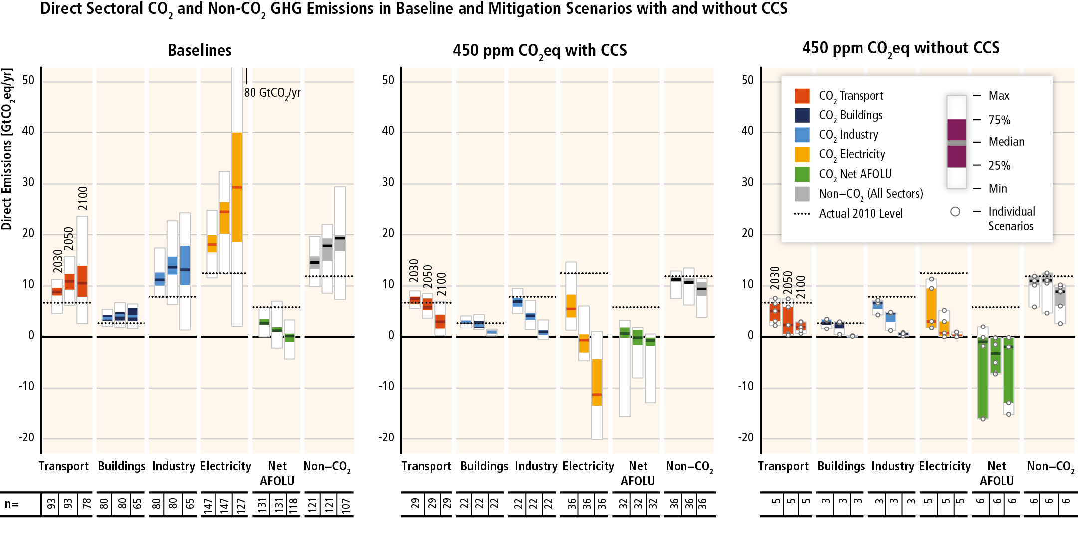
Mitigation requires changes throughout the economy. Efforts in one sector determine mitigation efforts in others.

Slide 16
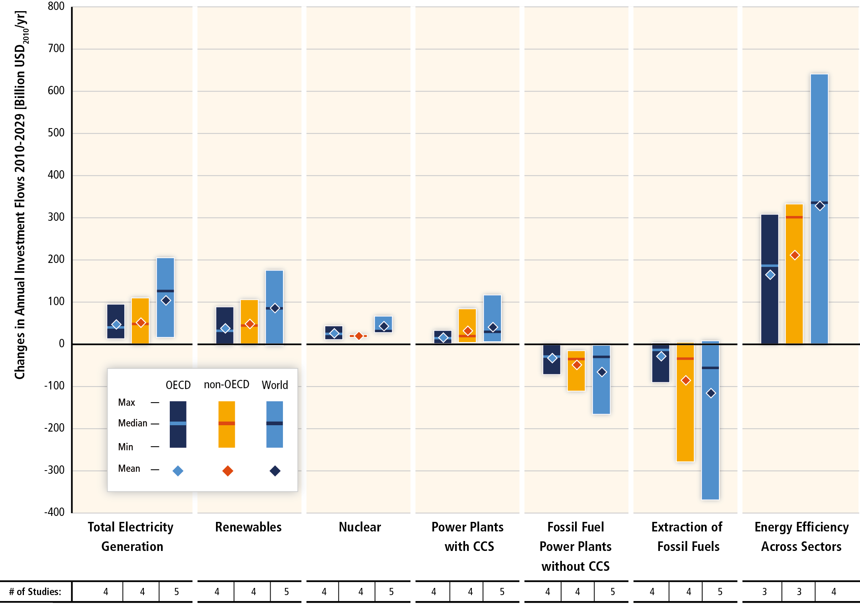
Substantial reductions in emissions would require large changes in investment patterns.

Slide 17
Since AR4, there has been an increased focus on policies designed to integrate multiple objectives, increase co-benefits and reduce adverse side-effects.
Sector-specific policies have been more widely used than economy-wide policies.
Regulatory approaches and information measures are widely used, and are often environmentally effective.
Since AR4, cap and trade systems for GHGs have been established in a number of countries and regions.
In some countries, tax-based policies specifically aimed at reducing GHG emissions–alongside technology and other policies–have helped to weaken the link between GHG emissions and GDP.
The reduction of subsidies for GHG-related activities in various sectors can achieve emission reductions, depending on the social and economic context.

Slide 18
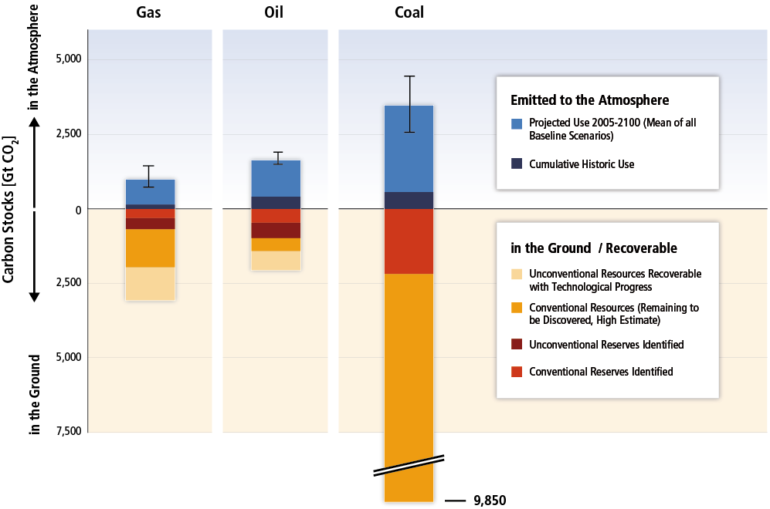
Climate change is a global commons problem that implies the need for international cooperation.

Slide 19
Effective mitigation will not be achieved if individual agents advance their own interests independently.
Existing and proposed international climate change cooperation arrangements vary in their focus and degree of centralization and coordination.
Issues of equity, justice, and fairness arise with respect to mitigation and adaptation.
Climate policy may be informed by a consideration of a diverse array of risks and uncertainties, some of which are difficult to measure, notably events that are of low probability but which would have a significant impact if they occur.

Slide 20
Least-cost mitigation scenarios rely on strong institutions.
Key institutional requirements:
All countries cooperate and begin to mitigate immediately.
They all introduce a globally uniform price on all GHG emissions.
They all allow the use of all key mitigation technologies.

Slide 21
www.mitigation2014.org

